Slide 1
Lecture on
Minimum Spanning Tree
(Prim’s Algorithm)
Avinash Kumar Sharma
Assistant Professor, Department of CSE
ABES INSTITUTE OF TECHNLOGY, GHAZIABAD

Slide 2
Notation
Tree-vertices: in the tree constructed so far
Non-tree vertices: rest of vertices
Prim’s Selection rule
Select the minimum weight edge between a tree-node and a non-tree node and add to the tree

Slide 3
The Prim algorithm Main Idea
Select a vertex to be a tree-node
while (there are non-tree vertices) {
if there is no edge connecting a tree node with a non-tree node
return “no spanning tree”
select an edge of minimum weight between a tree node and a non-tree node
add the selected edge and its new vertex to the tree
}
return tree
6
a
4
b
5
u
14
2
10
c
v
3
8
15
d
f

Slide 4
Prim’s Algorithm
Vertex based algorithm
Grows one tree T, one vertex at a time

Slide 5
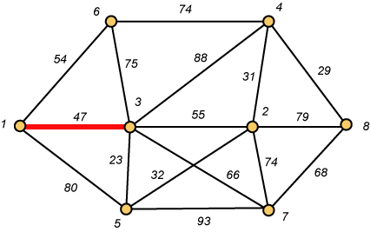
Prim – Step 1

Slide 6
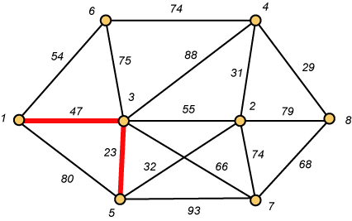
Prim – Step 2

Slide 7
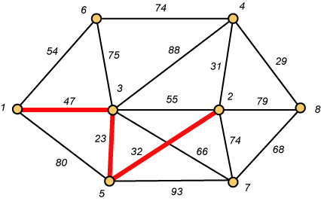
Prim – Step 3

Slide 8
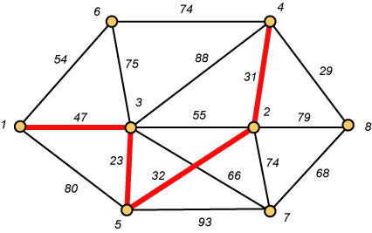
Prim – Step 4

Slide 9
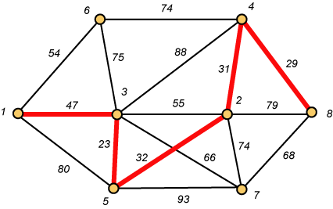
Prim – Step 5

Slide 10
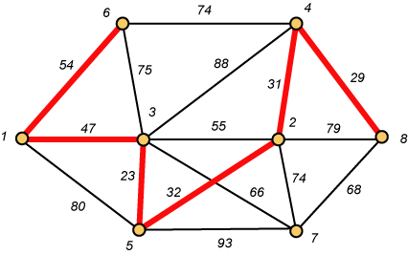
Prim – Step 6

Slide 11
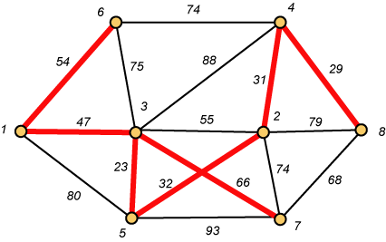
Prim – Step 7 Done!!
Weight (T) = 23 + 29 + 31 + 32 + 47 + 54 + 66 = 282

Slide 12
Prim Algorithm (2)
MST-Prim(G,w,r)
01 Q ← V[G] // Q – vertices out of T
02 for each u ∈ Q
03 key[u] ← ∞
04 key[r] ← 0 // r is the first tree node, let r=1
05 π[r] ← NIL
06 while Q ≠ ∅ do
07 u ← ExtractMin(Q) // making u part of T
08 for each v ∈ Adj[u] do
09 if v ∈ Q and w(u,v) < key[v] then
10 π[v] ← u
11 key[v] ← w(u,v)

Slide 13
Prim Algorithm:Variables
r:
  Grow the minimum spanning tree from the root vertex “r”.
Q:
  is a priority queue, holding all vertices that are not in the tree now.
key[v]:
  is the minimum weight of any edge connecting v to a vertex in the tree.
π [v]:
  names the parent of v in the tree.
T[v] –
  Vertex v is already included in MST if T[v]==1, otherwise, it is not included yet.

Slide 14
The execution of Prim's algorithm(moderate part)
8
7
the root vertex
b
c
d
9
4
2
a
11
i
14
e
4
7
6
8
10
h
g
f
1
2
V | a | b | c | d | e | f | g | h | i
T | 1 | 0 | 0 | 0 | 0 | 0 | 0 | 0 | 0
Key | 0 | - | - | - | - | - | - | - | -
π | -1 | - | - | - | - | - | - | - | -

Slide 15
The execution of Prim's algorithm(moderate part)
8
7
the root vertex
b
c
d
9
4
2
a
11
i
14
e
4
7
6
8
10
h
g
f
1
2
V | a | b | c | d | e | f | g | h | i
T | 1 | 0 | 0 | 0 | 0 | 0 | 0 | 0 | 0
Key | 0 | 4 | - | - | - | - | - | 8 | -
π | -1 | a | - | - | - | - | - | a | -

Slide 16
The execution of Prim's algorithm(moderate part)
8
7
the root vertex
b
c
d
9
4
2
a
11
i
14
e
4
7
6
8
10
h
g
f
1
2
Important: Update Key[v] only if T[v]==0
V | a | b | c | d | e | f | g | h | i
T | 1 | 1 | 0 | 0 | 0 | 0 | 0 | 0 | 0
Key | 0 | 4 | 8 | - | - | - | - | 8 | -
π | -1 | a | b | - | - | - | - | a | -

Slide 17
The execution of Prim's algorithm(moderate part)
8
7
the root vertex
b
c
d
9
4
2
a
11
i
14
e
4
7
6
8
10
h
g
f
1
2
V | a | b | c | d | e | f | g | h | i
T | 1 | 1 | 1 | 0 | 0 | 0 | 0 | 0 | 0
Key | 0 | 4 | 8 | 7 | - | 4 | - | 8 | 2
π | -1 | a | b | c | - | c | - | a | c

Slide 18
The execution of Prim's algorithm(moderate part)
8
7
the root vertex
b
c
d
9
4
2
a
11
i
14
e
4
7
6
8
10
h
g
f
1
2
V | a | b | c | d | e | f | g | h | i
T | 1 | 1 | 1 | 0 | 0 | 0 | 0 | 0 | 1
Key | 0 | 4 | 8 | 7 | - | 4 | 6 | 7 | 2
π | -1 | a | b | c | - | c | i | i | c

Slide 19
The execution of Prim's algorithm(moderate part)
8
7
the root vertex
b
c
d
9
4
2
a
11
i
14
e
4
7
6
8
10
h
g
f
1
2
V | a | b | c | d | e | f | g | h | i
T | 1 | 1 | 1 | 0 | 0 | 1 | 0 | 0 | 1
Key | 0 | 4 | 8 | 7 | 10 | 4 | 2 | 7 | 2
π | -1 | a | b | c | f | c | f | i | c

Slide 20
The execution of Prim's algorithm(moderate part)
8
7
the root vertex
b
c
d
9
4
2
a
11
i
14
e
4
7
6
8
10
h
g
f
1
2
V | a | b | c | d | e | f | g | h | i
T | 1 | 1 | 1 | 0 | 0 | 1 | 1 | 0 | 1
Key | 0 | 4 | 8 | 7 | 10 | 4 | 2 | 1 | 2
π | -1 | a | b | c | f | c | f | g | c

Slide 21
The execution of Prim's algorithm(moderate part)
8
7
the root vertex
b
c
d
9
4
2
a
11
i
14
e
4
7
6
8
10
h
g
f
1
2
V | a | b | c | d | e | f | g | h | i
T | 1 | 1 | 1 | 0 | 0 | 1 | 1 | 1 | 1
Key | 0 | 4 | 8 | 7 | 10 | 4 | 2 | 1 | 2
π | -1 | a | b | c | f | c | f | g | c

Slide 22
The execution of Prim's algorithm(moderate part)
8
7
the root vertex
b
c
d
9
4
2
a
11
i
14
e
4
7
6
8
10
h
g
f
1
2
V | a | b | c | d | e | f | g | h | i
T | 1 | 1 | 1 | 1 | 0 | 1 | 1 | 1 | 1
Key | 0 | 4 | 8 | 7 | 9 | 4 | 2 | 1 | 2
π | -1 | a | b | c | d | c | f | g | c

Slide 23
The execution of Prim's algorithm(moderate part)
8
7
the root vertex
b
c
d
9
4
2
a
11
i
14
e
4
7
6
8
10
h
g
f
1
2
V | a | b | c | d | e | f | g | h | i
T | 1 | 1 | 1 | 1 | 1 | 1 | 1 | 1 | 1
Key | 0 | 4 | 8 | 7 | 9 | 4 | 2 | 1 | 2
π | -1 | a | b | c | d | c | f | g | c

Slide 24
Complexity: Prim Algorithm
MST-Prim(G,w,r)
01 Q ← V[G] // Q – vertices out of T
02 for each u ∈ Q
03 key[u] ← ∞
04 key[r] ← 0
05 π[r] ← NIL
06 while Q ≠ ∅ do
07 u ← ExtractMin(Q) // making u part of T
08 for each v ∈ Adj[u] do
09 if v ∈ Q and w(u,v) < key[v] then
10 π[v] ← u
11 key[v] ← w(u,v)
O(V)
O(V)
Heap: O(lgV)
Overall: O(E)
Decrease Key: O(lgV)
Overall complexity: O(V)+O(V lg V+E lg V) = O(E lg V)

Slide 25
Overall Complexity Analysis
O(n²)
  When we don’t use heap
  To find the minimum element, we traverse the “KEY” array from beginning to end
  We use adjacency matrix to update KEY.
O(ElogV)
  When min-heap is used to find the minimum element from “KEY”.
O(E+VlogV)
  When fibonacci heap is used to find the minimum element from “KEY”.

Slide 26
Thank You..!

